Slide 1
Team 8
Akshaynath R
Amrutha M.U
Sachin Govind
Sreelal K.M
GUIDE : Prof Swaraj K. P

Slide 2
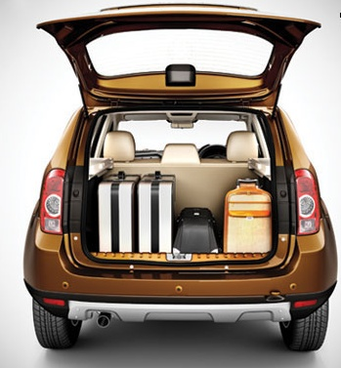
UDIO
Lets you share your
cargo space

Slide 3
Our mission is to create a peer to peer network for package delivery.

Slide 4
The problem
Package delivery is time consuming
Package delivery is a costly process
Package delivery involves complex sorting works

Slide 5
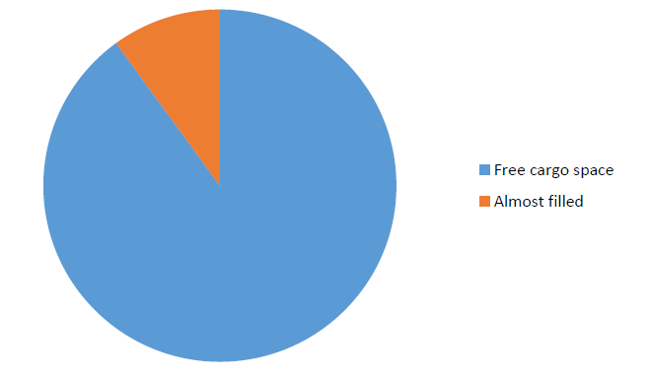
What led to our solution ?

Slide 6
The solution
Hundreds of people travel in their vehicles with their cargo space empty.
If we can match a sender with a person travelling in the same direction , he can deliver the product in less time and with less cost
Match the sender and traveller

Slide 7

How it works
Step 1
Select Destination
The sender selects the destination to send the package and specifies the size of package.

Slide 8

How it works
Step 2
Match
Udio matches the sender with a trusted traveller registered with our service ,going in the same direction.

Slide 9

How it works
Step 3
Acceptance
Both sender and traveler has to accept the delivery request.

Slide 10
Product Design
The software consist of the following Modules
Sender Module
Rider Module
Algorithm module
Admin Module

Slide 11
The Sender module consists of:
Sender login: Sender can register with the website and create an account. He can login with the username and password.
Profile: Sender can update his profile page. It will also show all the past package deliveries
Search : Sender can search for the Rider to sent his package
Package details: Sender can list the details about package to be sent, like the dimension, weight, type of item in the package etc.
Tracking: Sender can track the package through maps.
Sender logout: Sender can logout of the site whenever required

Slide 12
The Rider module consists of:
Rider Login: Any person can register as a Rider. He needs to submit details about his vehicle and Driver’s licence ID
Profile : Rider can create the profile with the information about his, vehicle ,place etc
Package delivery : Shows details about the riders past package deliveries and new delivery requests
Payment: Shows payment details. Rider needs to set up his bank account to receive the payment
Rider Logout : Rider can logout of site whenever required

Slide 13
UI DESIGNS

Slide 14
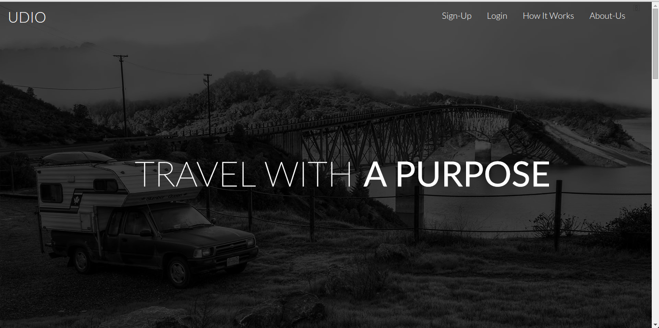
Home Page

Slide 15
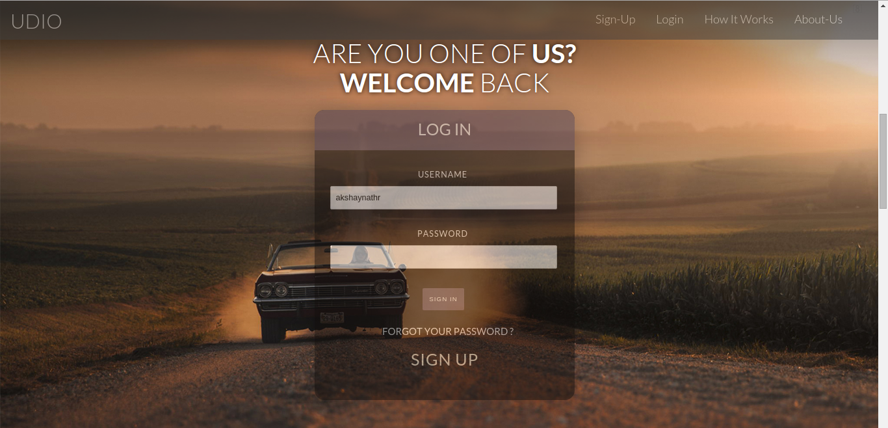
Log In

Slide 16
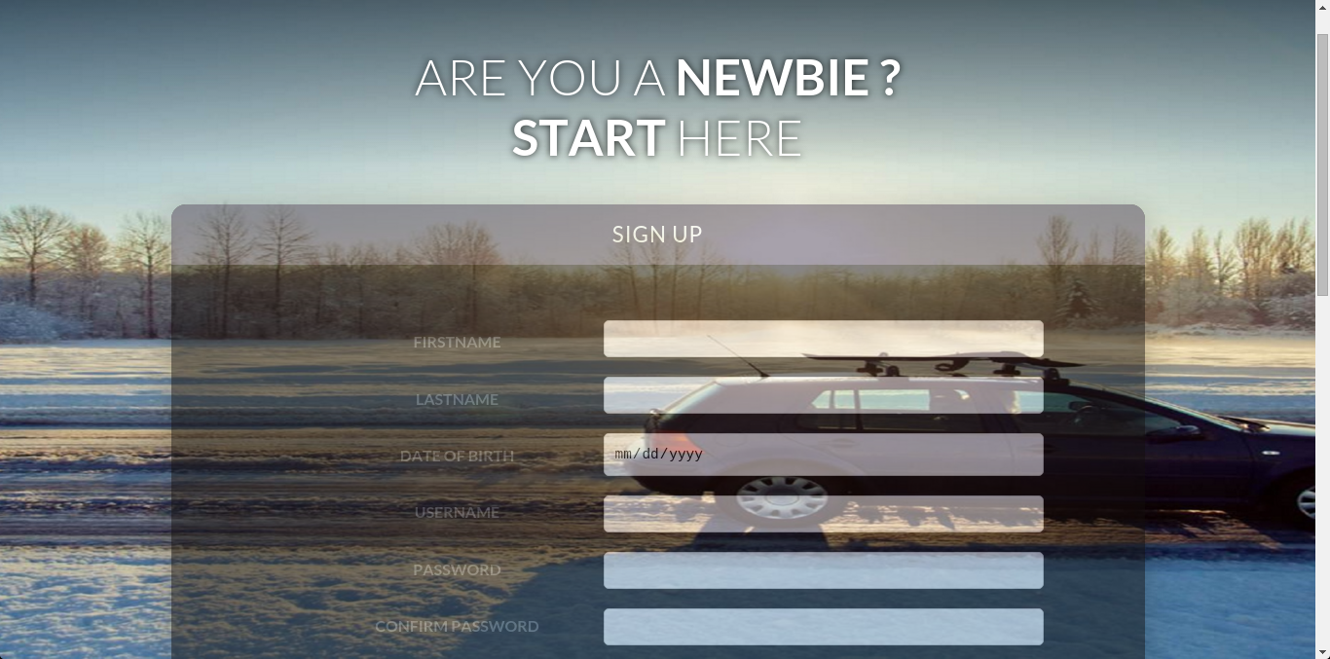
Register

Slide 17
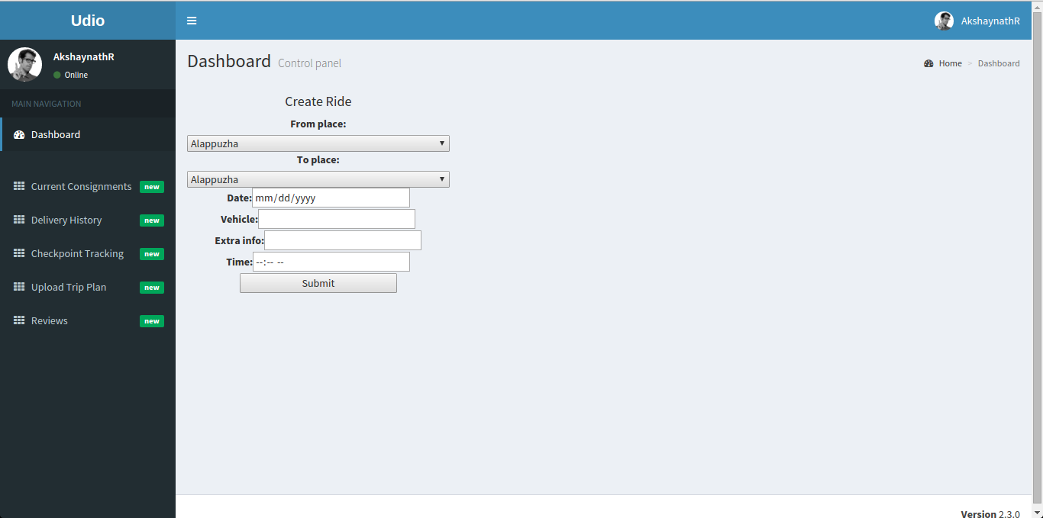
Dashboard: Create Ride

Slide 18
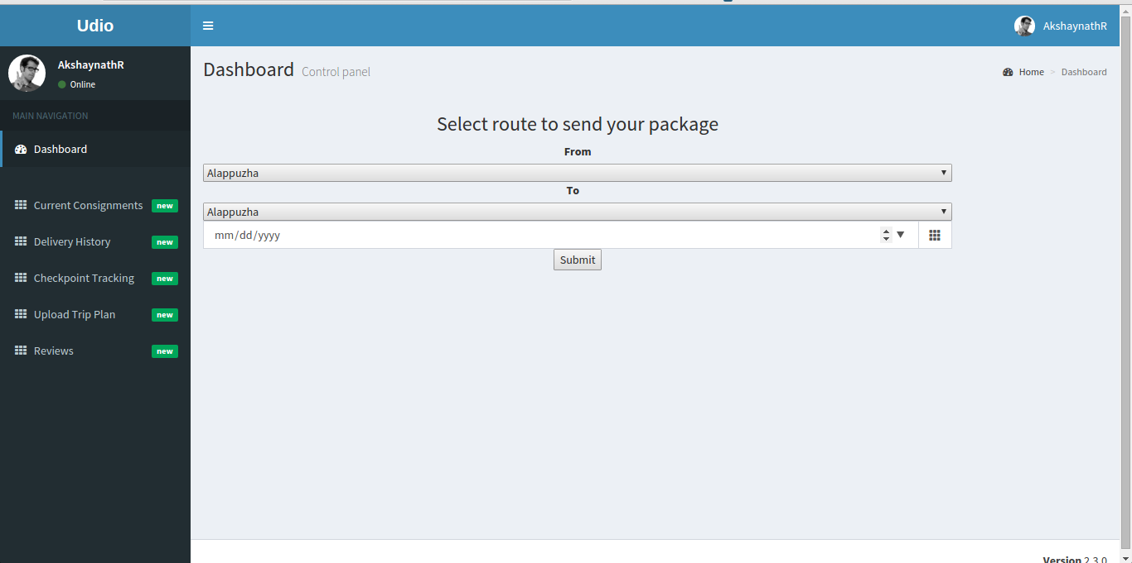
Dashboard: Send Package

Slide 19
Features

Slide 20
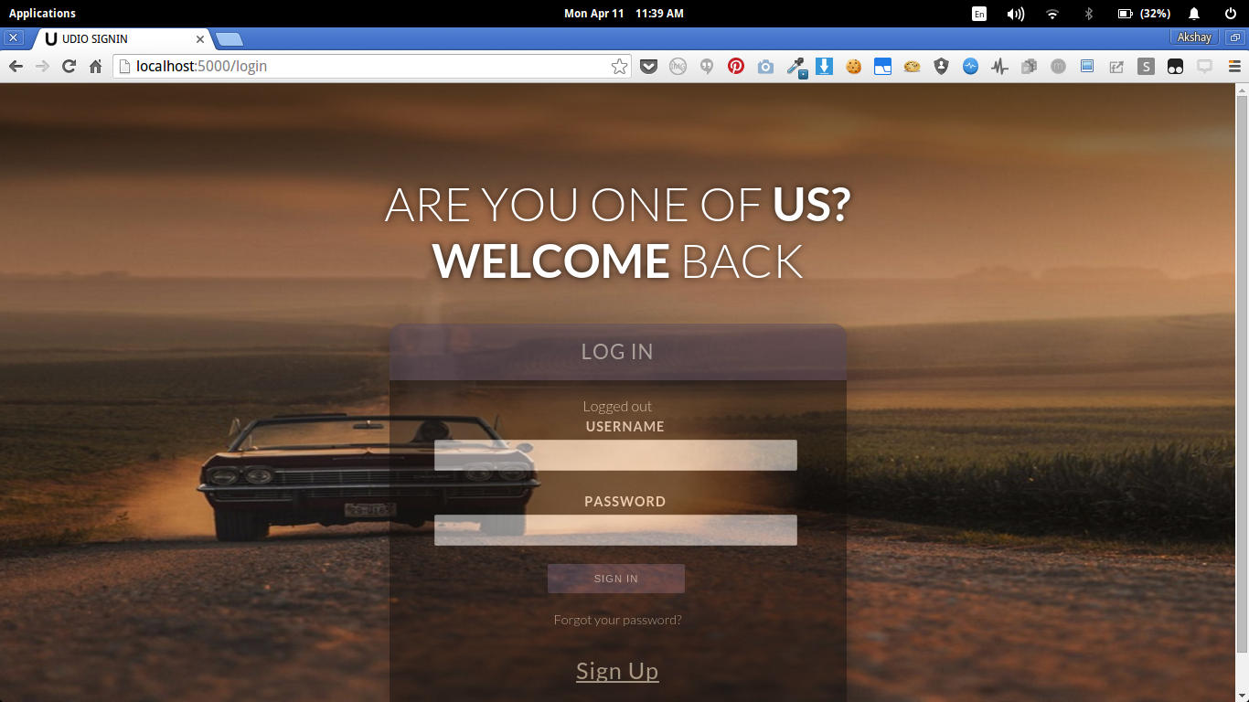
Login and Logout with client side session

Slide 21
Searching rides on required routes

Slide 22
CREATING RIDE

Slide 23
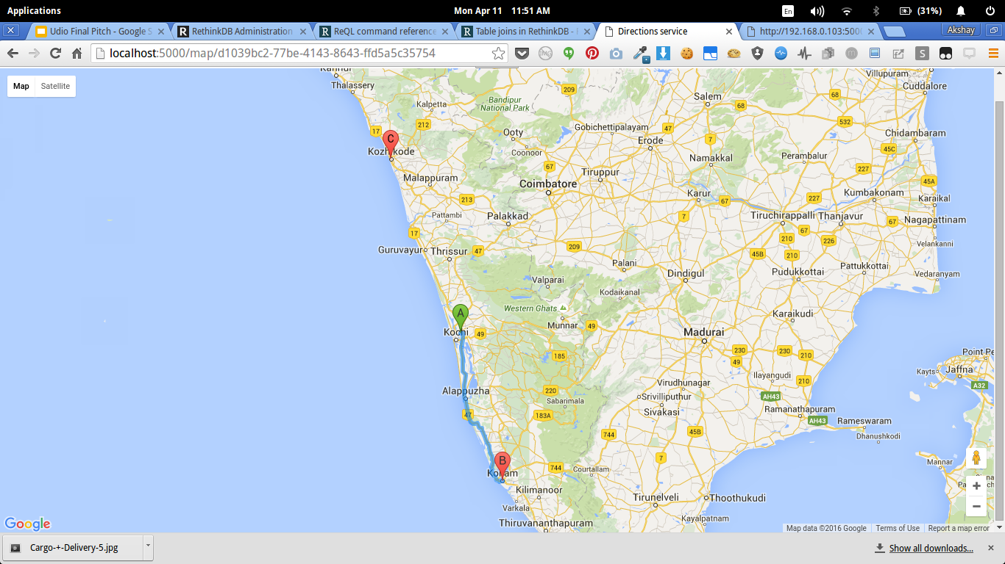
Real Time tracking of the ride

Slide 24
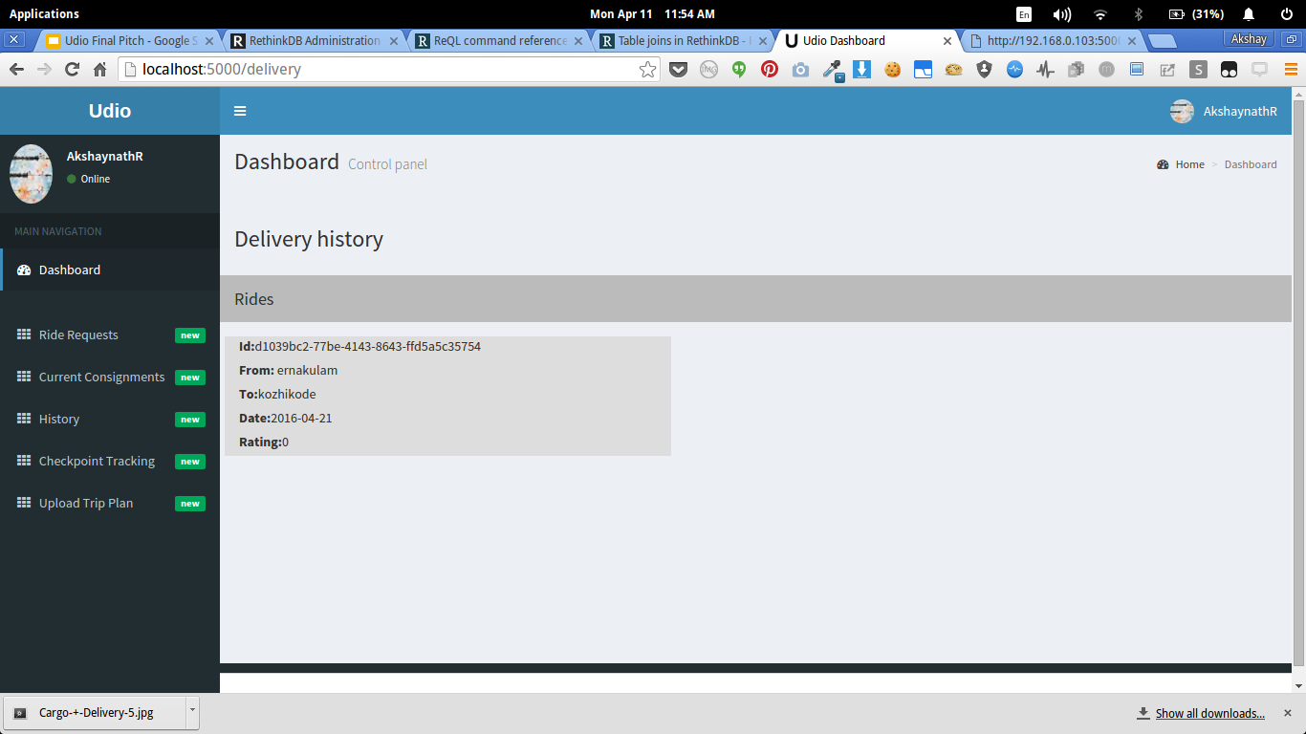
Keeps all past records of packages sent and rides created

Slide 25
BACKEND DESIGN

Slide 26

DATABASE
NO SQL database
Optimized to handle big data
Highly scalable

Slide 27

Web Framework

